Slide 1
El Cinco de Mayo
By Steve Yeh

Slide 2
History
El Cinco De Mayo, a holiday observed in areas in the United States and Mexico, was first observed by Mexicans living in California during the American Civil War. This was the celebration of when Mexican forces defeated the French at the Battle of Puebla on May 5, 1862. This was a battle in the Franco-Mexican War. It celebrated the superb victory by General Ignacio Zaragoza (Zaragosa) Seguin’s poorly equipped militia of 4,500 against a better trained French army of more than 5,000. The victory further boosted the morale and spirit of Mexican patriots who wanted to drive the French out. The victory was a glorious moment for Mexicans and symbolic moment for the Mexican government. The Franco-Mexican War started after the American-Mexican War ended. The French began to invade Mexico. After the Mexican victory at Puebla, French commander Napoleon Bonaparte transported nearly 30,000 troops overseas to put an ease to the war. The French later captured Mexico City, the capital of Mexico. Americans decided to help Mexico with military and political assistance to oust the French power. The French ruler of Mexico, Archduke Maximilian of Austria, was captured and executed by the Mexicans and the French reign in Mexico was forever ridden.

Slide 3
Reasons of Celebration
In the some regions, particularly Puebla, Mexicans celebrate El Cinco de Mayo to commemorate the heroic fight at the Battle of Puebla (La Batalla de Puebla)
In the United States (Estados Unidos), Mexican- Americans (Chicanos) celebrate Mexican culture including the food, music , beverages, customs, heritage and ancestry
It celebrates the relationship between Mexico and the United States
Many Mexican- Americans (Chicanos) believe Cinco de Mayo to be a holiday to celebrate their loyalty and patriotism to both Mexico and the United States
In Mexico, it is not a big holiday, only a regional holiday of Puebla; El 16 de septiembre is more of the real independence day in Mexico

Slide 4
Celebrations
The music is very unique, including baile folklórico and mariachi
Mariachi is a genre of music that includes the instruments of the guitar, violin, trumpet, guitarrón- a low bass guitar and the vihuela- a guitar that has a tune higher than a guitarrón but lower than a regular guitar
There are many parades celebrating the Mexican victory- mostly in the state of Puebla; in the United States, the parades mainly celebrate the Mexican culture
Alcohol is a big part of the celebration, making Cinco de Mayo the 2nd most alcohol consumption holiday in the United States
Traditional Mexican food is eaten on Cinco de Mayo including molé, nachos, tacos et cetera
There is also traditional Mexican folk dancing during Cinco de Mayo with girls wearing a typically red, green and white dress

Slide 5
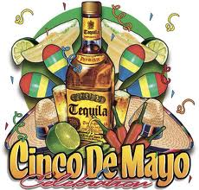
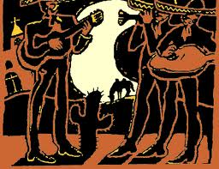
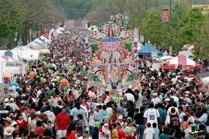
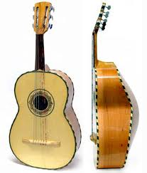
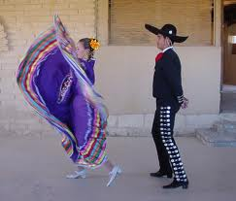
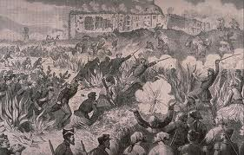
Pictures

Slide 6
Bibliography
http://www.mexonline.com/cinco-de-mayo.htm
http://www.mexica.net/literat/Cinco.php
http://bbq.about.com/od/seasonal/a/aa042906a.htm
http://cincodemayo.org/
http://www.history.com/topics/cinco-de-mayo
http://homeschooling.about.com/cs/unitssubjhol/a/cincodemayo.htm
http://en.wikipedia.org/wiki/Cinco_de_Mayo#Observances

